Slide 1
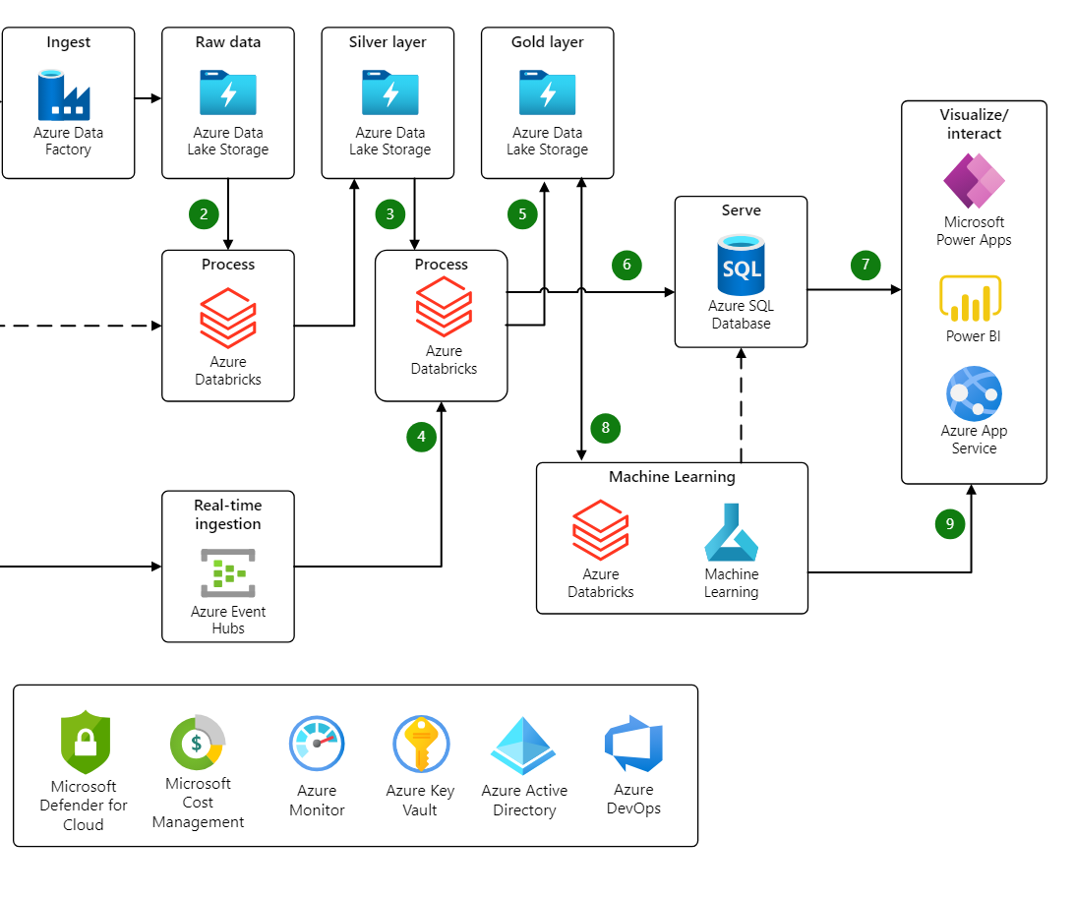
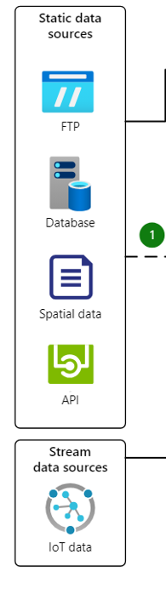
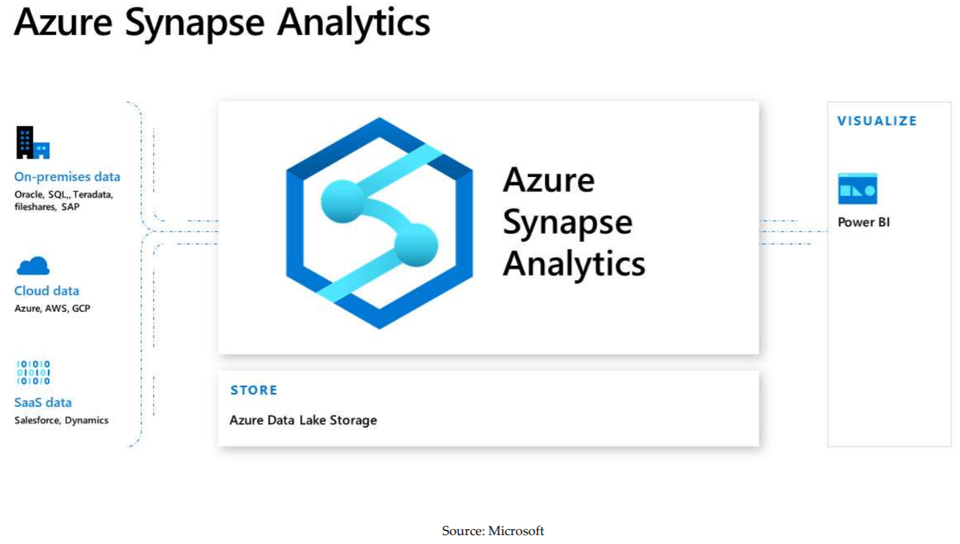
Azure Data Architecture

Slide 2
BI Solution Architecture
Corporate Strategy
BI Vision
BI Strategy
BI Mission statement
BI Stake-holders
Business Intelligence Solution Requirements
Business Intelligence Solution Requirements
Business Architecture
Information Architecture
Application Architecture
Infrastructure Architecture
BI Solution Architecture
Data Architecture
Integration Architecture
Service Architecture

Slide 3
Business Architecture
Business Strategy
Business Objectives
Business Structure
Business Capabilities
Business Process Area
Process Flows
Ways of Working
Business Analysis
Interviews
Requirements Workshops

Slide 4
Information Architecture
Data Ownership
Data Contracts
Information Architecture
Legacy Mainframe
legacy
Third Party Data
SAP ERP
Data Capture System
Landing Space
Finance Application
Staging Tables
Call Centre
Data Marts
Operational Data Store
Ecommerce Web
SAP BW
GPS Satellites
Third Normal Form Tables
SAP HANA
Point of Sale
Reference Data
Barcode Logistics
Slab
Loyalty Cards
Web Clicks
legacy
Structural Design
Shared Info Env
Flow & Lineage
Meaning & Use

Slide 5
How All The Applications Hook Together
SAP BusinessObjects BI 4.1
Application Architecture
CORBA
Apache Tomcat
SAP BusinessObjects Data Services
SAP BusinessObjects Predictive Analytics
SAP BusinessObjects Design Studio
SAP BusinessObjects Explorer
SAP BusinessObjects Mobile Server
SAP HANA
SAP BW
ER Win
MS SQL Sever 2012
MS SQL Server 2012 Data Mining
I’ve Incorporated My Technology Architecture Here & Also With Infrastructure

Slide 6
Development
Infrastructure Architecture
Test
Pre-Production
Production
Sizing
Procurement
Hardware
In Place Before BI Applications
Version / Patching
Licensing Models
Recovery / Back Up
HA /DR
Security
Cloud
Data Virtualisation
Data Federation
Storage
Communication

Slide 7
Data Warehousing
Data Architecture
Requirements Gathering
Entity Modelling
Dimensional Modelling
Logical Model Mgmt
Physical Model Mgmt
Reference Data
ODS
Real-time Data
Near Real-time Data
Big Data
Master Data Management
Data Profiling
Data Quality
Metadata
Data Governance
ETL System
Sub Systems
Source Systems

Slide 8
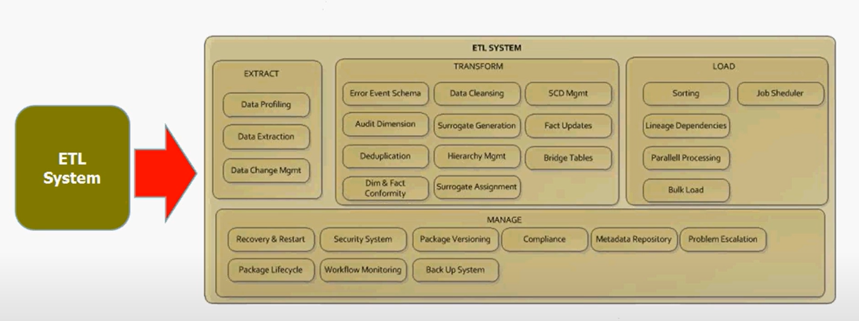

Slide 9
Integration Architecture
Supported Platforms
Distributed Architecture
CORBA
Service Oriented Architecture
Web Services
Security
Portal Integration

Slide 10
Service
Architecture
Service Level Agreements
Data Delivery
Data Quality
Change Requests
Defect Fixes
Upgrades
Maintenance
Back Ups

Slide 11
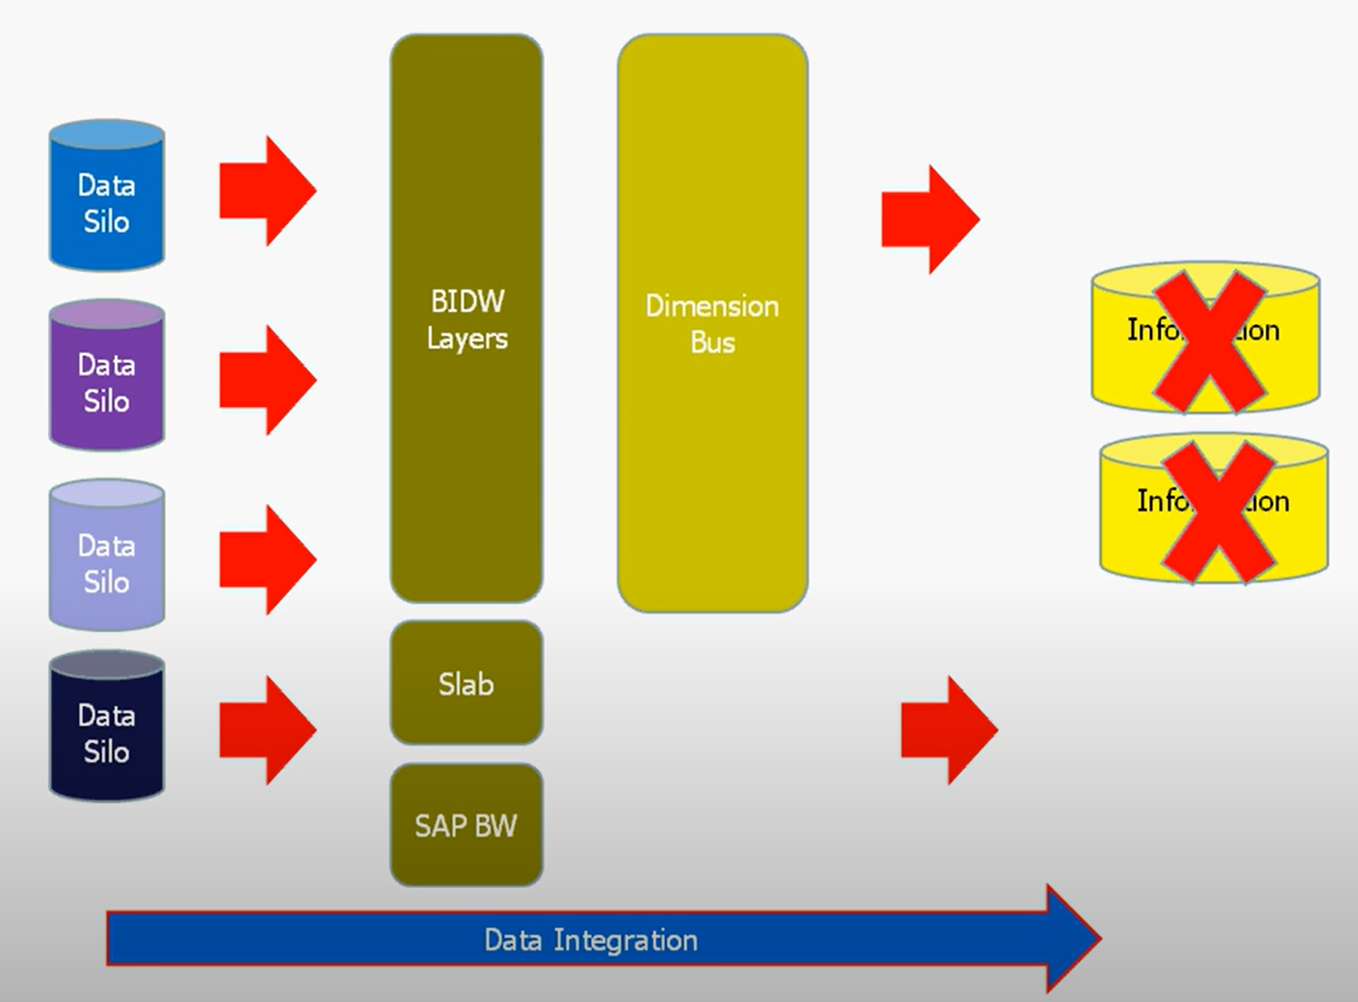
Data Integration

Slide 12
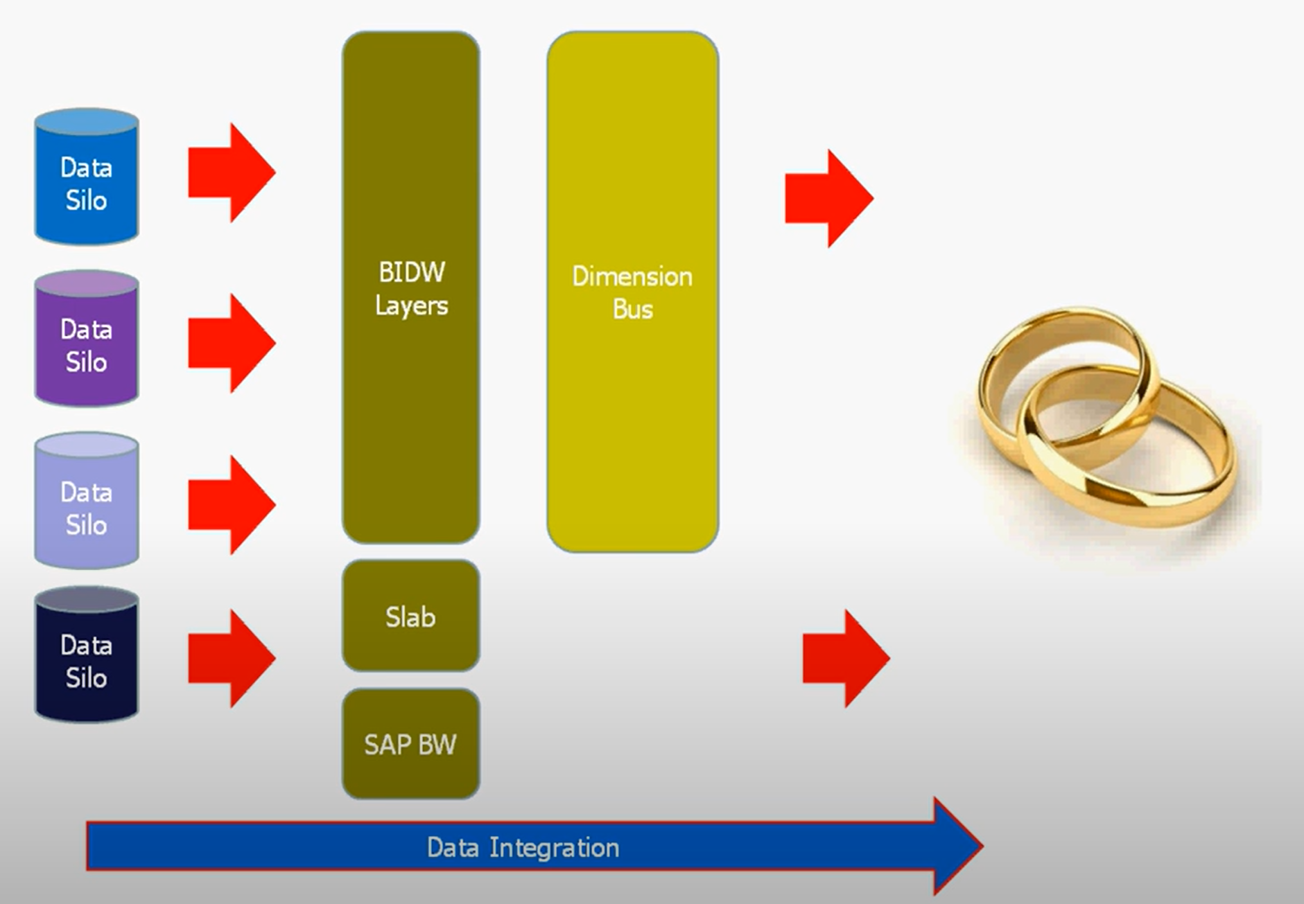
Data Integration

